Slide 1

Customer Retention
E-retail factors for customer activation and retention: A case study from Indian e-commerce customers.
FLIP ROBO REMOTE INTERNSHIP
Developed By:
Deepam Purkayastha

Slide 2
Problem Statement:
Customer satisfaction has emerged as one of the most important factors that guarantee the success of online store; it has been posited as a key stimulant of purchase, repurchase intentions and customer loyalty. A comprehensive review of the literature, theories and models have been carried out to propose the models for customer activation and customer retention. Five major factors that contributed to the success of an e-commerce store have been identified as: service quality, system quality, information quality, trust and net benefit. The research furthermore investigated the factors that influence the online customers repeat purchase intention. The combination of both utilitarian value and hedonistic values are needed to affect the repeat purchase intention (loyalty) positively. The data is collected from the Indian online shoppers. Results indicate the e-retail success factors, which are very much critical for customer satisfaction.
Objective:
The objective is to apply the analytical skills to provide findings and conclusion that would help to predict customer retention for a E-Retail company using their data on users provided over period of time. Using the model, I was tasked with determining which features were most influential in loss of retention and then making a plan for how the company could use this information to increase retention.

Slide 3
Data Pre-processing Done
Importing Libraries.
Read the CSV file and convert into data frame.
Checking the data dimensions for the original dataset.
Looking for null values if any, in heat map.
Checking the summary of the dataset.
Checking unique values.
Checking all the categorical columns in the dataset.
Visualizing each features using matplotlib and Seaborn.
Performed encoding.
Checked for co-relation.
Checked for Outliers/Skewness.

Slide 4
Data analysis flowchart
Import Libraries
Dataset Collection
Data preprocessing
Encoding
EDA
Checking Null Values
Checked for co-relation
Checked for Outliers/Skewness
Proceed for Model building(Train/Test)

Slide 5
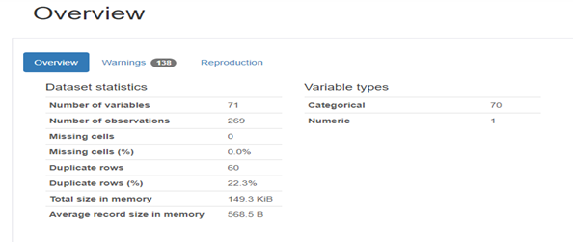
Exploratory Data Analysis through Visualizations
Profiling Report analysis
Checked for the trend and patterns for each features to decide feature importance.
Visualizing each features using matplotlib and Seaborn to check the relationship and count of each features.
Analysing both numerical and categorical columns separately.

Slide 6
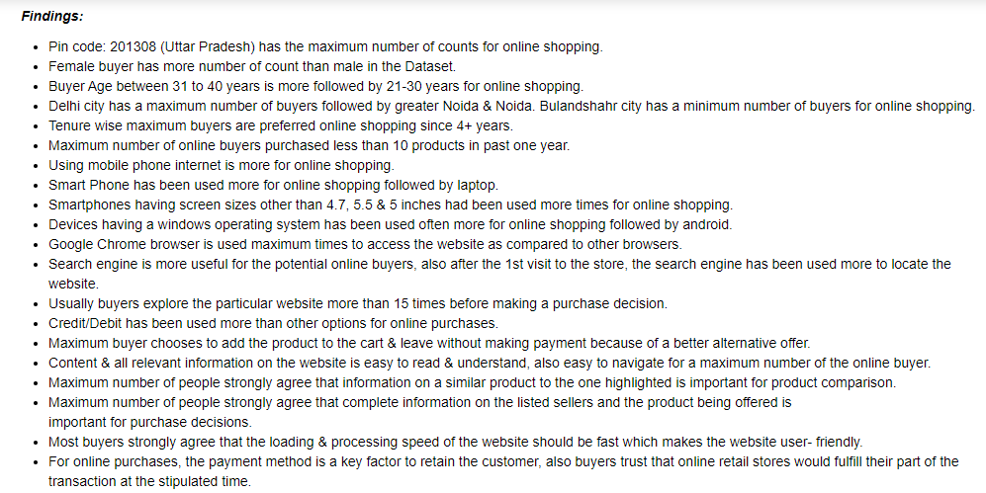

Slide 7
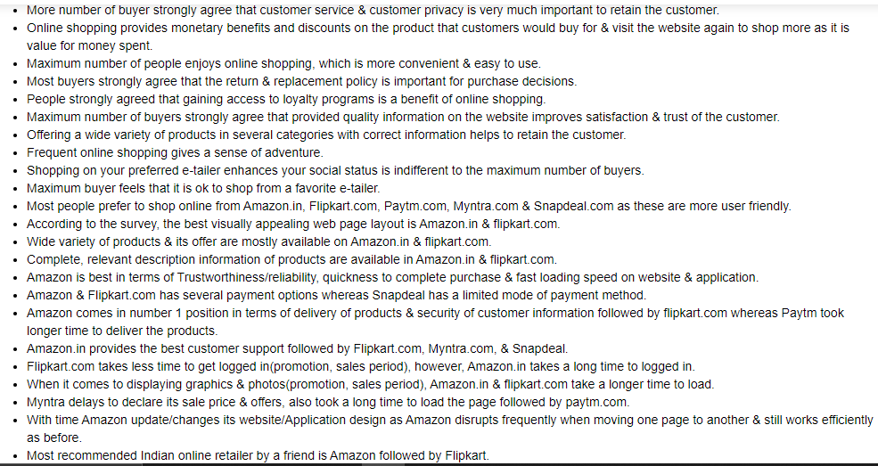

Slide 8
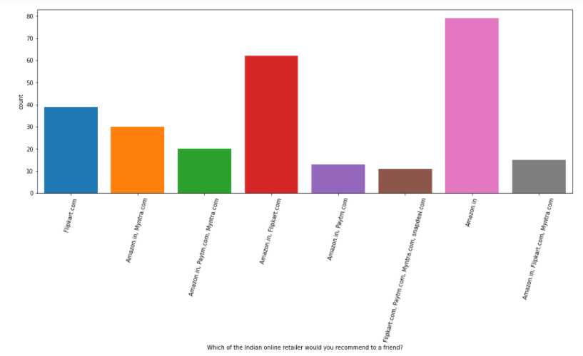
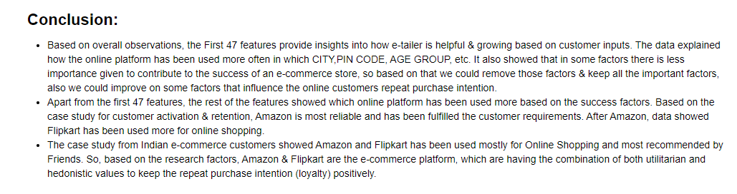

Slide 9
Thank you

